Slide 1
Functional Dependencies and Normalization for Relational Databases
Instructor: Dr. Sonam Nahar
Copyright © 2007 Ramez Elmasri and Shamkant B. Navathe

Slide 2
Chapter Outline
1 Informal Design Guidelines for Relational Databases
  1.1Semantics of the Relation Attributes
  1.2 Redundant Information in Tuples and Update Anomalies
  1.3 Null Values in Tuples
  1.4 Spurious Tuples
2 Functional Dependencies (FDs)
  2.1 Definition of FD
  2.2 Inference Rules for FDs
  2.3 Equivalence of Sets of FDs
  2.4 Minimal Sets of FDs
Slide 10- <number>

Slide 3
Chapter Outline
3 Normal Forms Based on Primary Keys
  3.1 Normalization of Relations
  3.2 Practical Use of Normal Forms
  3.3 Definitions of Keys and Attributes Participating in Keys
  3.4 First Normal Form
  3.5 Second Normal Form
  3.6 Third Normal Form
4 General Normal Form Definitions (For Multiple Keys)
5 BCNF (Boyce-Codd Normal Form)
Slide 10- <number>

Slide 4
1 Informal Design Guidelines for Relational Databases (1)
What is relational database design?
  The grouping of attributes to form "good" relation schemas
Two levels of relation schemas
  The logical "user view" level
  The storage "base relation" level
Design is concerned mainly with base relations
What are the criteria for "good" base relations?
Slide 10- <number>

Slide 5
Informal Design Guidelines for Relational Databases (2)
We first discuss informal guidelines for good relational design
Then we discuss formal concepts of functional dependencies and normal forms
  - 1NF (First Normal Form)
  - 2NF (Second Normal Form)
  - 3NF (Third Normal Form)
  - BCNF (Boyce-Codd Normal Form)
Additional types of dependencies, further normal forms, relational design algorithms by synthesis are discussed in Chapter 11
Slide 10- <number>

Slide 6
1.1 Semantics of the Relation Attributes
GUIDELINE 1: Informally, each tuple in a relation should represent one entity or relationship instance. (Applies to individual relations and their attributes).
  Attributes of different entities (EMPLOYEEs, DEPARTMENTs, PROJECTs) should not be mixed in the same relation
  Only foreign keys should be used to refer to other entities
  Entity and relationship attributes should be kept apart as much as possible.
Bottom Line: Design a schema that can be explained easily relation by relation. The semantics of attributes should be easy to interpret.
Slide 10- <number>

Slide 7
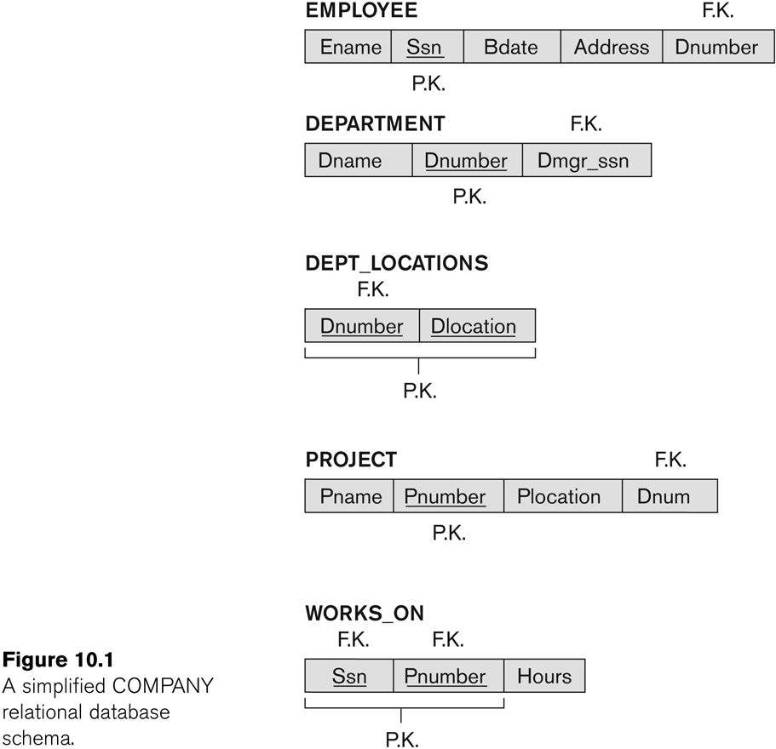
Figure 10.1 A simplified COMPANY relational database schema
Slide 10- <number>

Slide 8
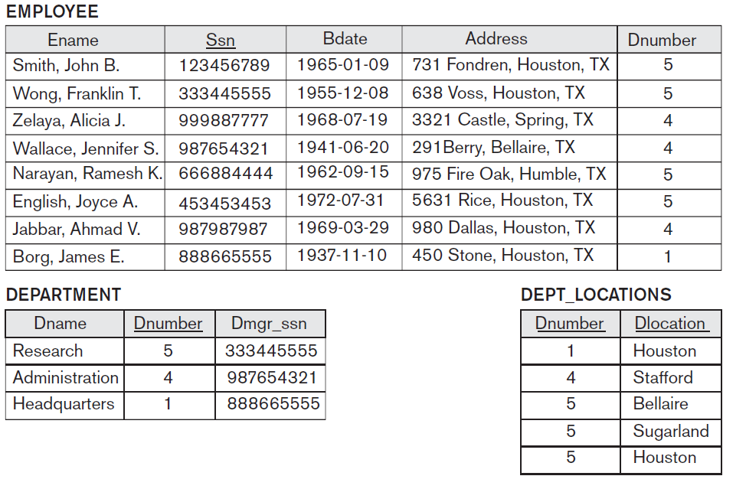
Figure 10.1 A simplified COMPANY relational database schema
Slide 10- <number>

Slide 9
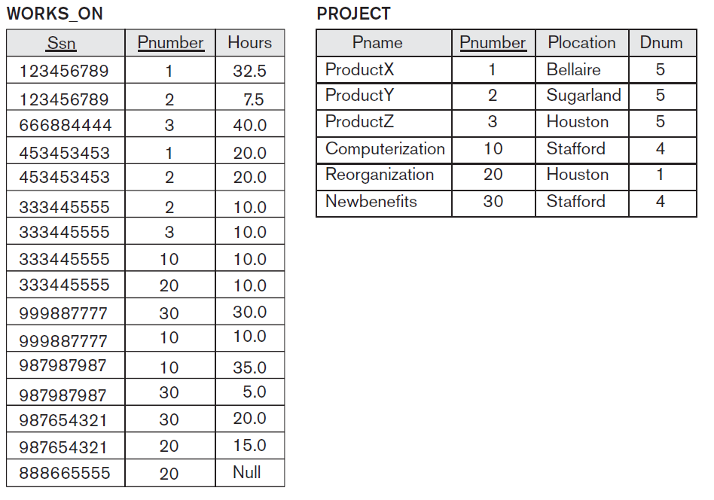
Figure 10.1 A simplified COMPANY relational database schema
Slide 10- <number>

Slide 10
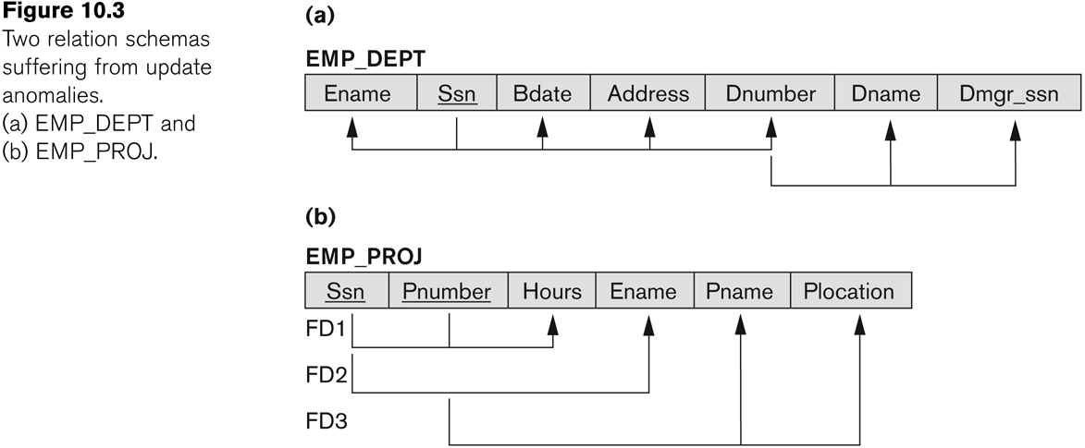
Figure 10.3 Two relation schemas suffering from update anomalies
Slide 10- <number>

Slide 11
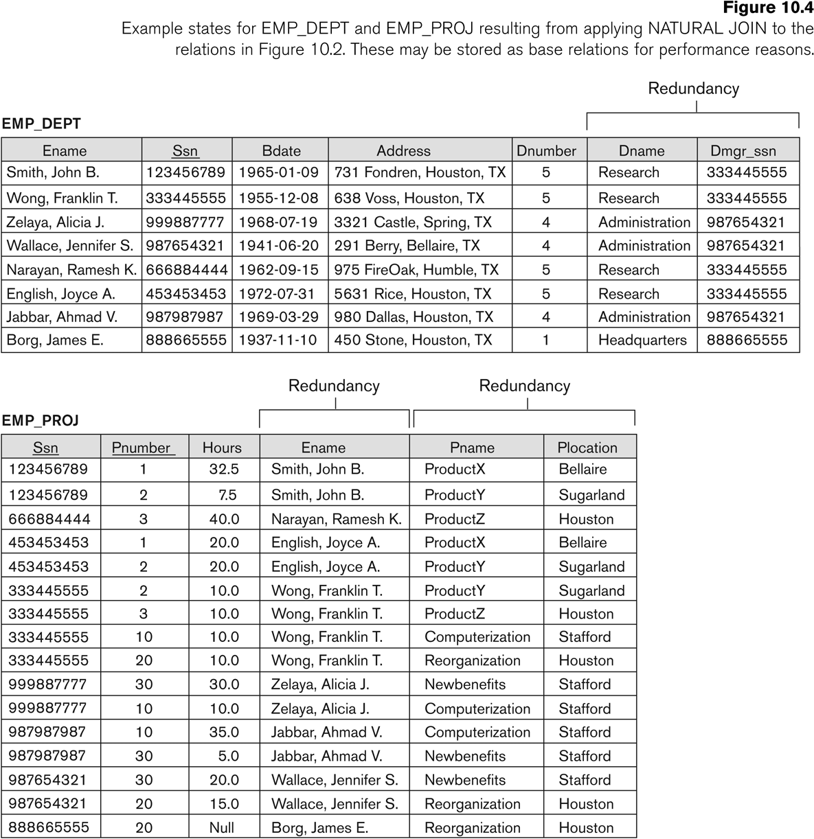
Figure 10.4 Example States for EMP_DEPT and EMP_PROJ
Slide 10- <number>

Slide 12
1.2 Redundant Information in Tuples and Update Anomalies
Information is stored redundantly
  Wastes storage
  Causes problems with update anomalies
    Insertion anomalies
    Deletion anomalies
    Modification anomalies
Slide 10- <number>

Slide 13
EXAMPLE OF AN UPDATE ANOMALY
Consider the relation:
  EMP_PROJ(Emp#, Proj#, Ename, Pname, No_hours)
Update Anomaly:
  Changing the name of project number P1 from “Billing” to “Customer-Accounting” may cause this update to be made for all 100 employees working on project P1.
Slide 10- <number>

Slide 14
EXAMPLE OF AN INSERT ANOMALY
Consider the relation:
  EMP_PROJ(Emp#, Proj#, Ename, Pname, No_hours)
Insert Anomaly:
  Cannot insert a project unless an employee is assigned to it.
Conversely
  Cannot insert an employee unless an he/she is assigned to a project.
Slide 10- <number>

Slide 15
EXAMPLE OF AN DELETE ANOMALY
Consider the relation:
  EMP_PROJ(Emp#, Proj#, Ename, Pname, No_hours)
Delete Anomaly:
  When a project is deleted, it will result in deleting all the employees who work on that project.
  Alternately, if an employee is the sole employee on a project, deleting that employee would result in deleting the corresponding project.
Slide 10- <number>

Slide 16
Guideline to Redundant Information in Tuples and Update Anomalies
GUIDELINE 2:
  Design a schema that does not suffer from the insertion, deletion and update anomalies.
  If there are any anomalies present, then note them so that applications can be made to take them into account.
Slide 10- <number>

Slide 17
1.3 Null Values in Tuples
GUIDELINE 3:
  Relations should be designed such that their tuples will have as few NULL values as possible
  Attributes that are NULL frequently could be placed in separate relations (with the primary key)
Reasons for nulls:
  Attribute not applicable or invalid
  Attribute value unknown (may exist)
  Value known to exist, but unavailable
Slide 10- <number>

Slide 18
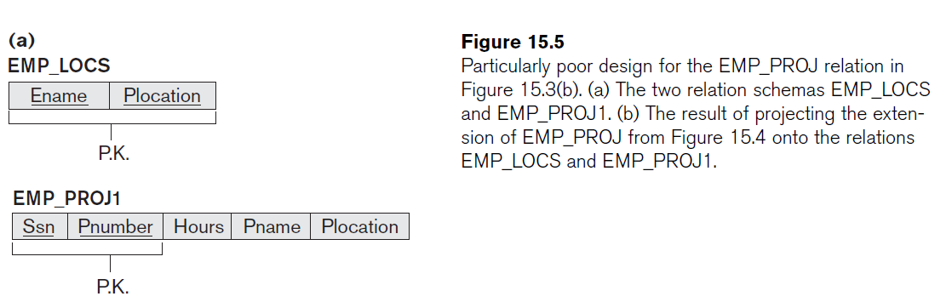
1.4 Spurious Tuples
Slide 10- <number>

Slide 19
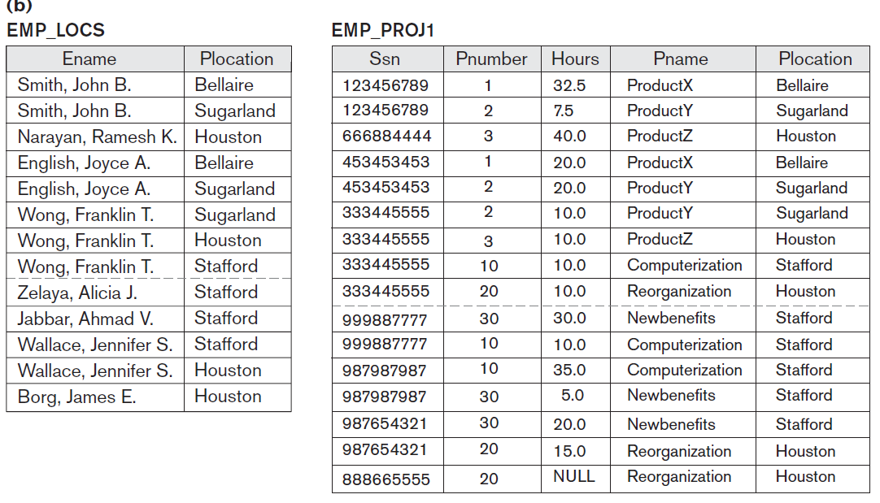
1.4 Spurious Tuples
Slide 10- <number>

Slide 20
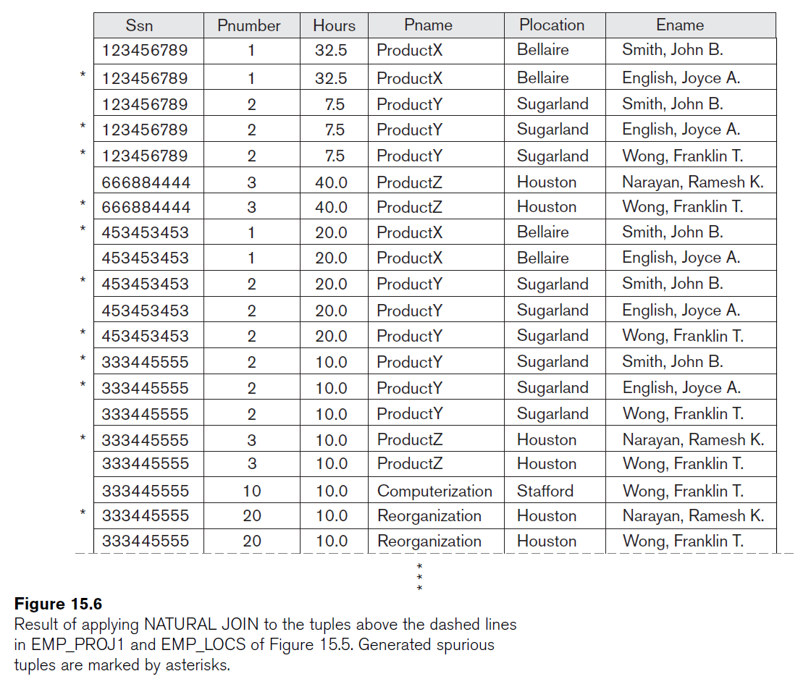
1.4 Spurious Tuples
Slide 10- <number>

Slide 21
1.4 Spurious Tuples
Bad designs for a relational database may result in erroneous results for certain JOIN operations
The "lossless join" property is used to guarantee meaningful results for join operations
Eg., Plocation is neither a primary key or foreign key.
GUIDELINE 4:
  The relations should be designed to satisfy the lossless join condition.
  No spurious tuples should be generated by doing a natural-join of any relations.
Slide 10- <number>

Slide 22
Spurious Tuples (2)
There are two important properties of decompositions:
  Non-additive or losslessness of the corresponding join
  Preservation of the functional dependencies.
Note that:
  Property (a) is extremely important and cannot be sacrificed.
  Property (b) is less stringent and may be sacrificed.
Slide 10- <number>

Slide 23
2.1 Functional Dependencies (1)
Functional dependencies (FDs)
  Are used to specify formal measures of the "goodness" of relational designs
  And keys are used to define normal forms for relations
  Are constraints that are derived from the meaning and interrelationships of the data attributes
A set of attributes X functionally determines a set of attributes Y if the value of X determines a unique value for Y
Slide 10- <number>

Slide 24
Functional Dependencies (2)
X -> Y holds if whenever two tuples have the same value for X, they must have the same value for Y
  For any two tuples t1 and t2 in any relation instance r(R): If t1[X]=t2[X], then t1[Y]=t2[Y]
X -> Y in R specifies a constraint on all relation instances r(R)
Written as X -> Y; can be displayed graphically on a relation schema as in Figures. ( denoted by the arrow: ).
FDs are derived from the real-world constraints on the attributes
Slide 10- <number>

Slide 25
Functional Dependencies (3)
Values of the Y component of a tuple in r depend on, or are determined by, the values of the X component; alternatively, the values of the X component of a tuple uniquely (or functionally) determine the values of the Y component. We also say that there is a functional dependency from X to Y, or that Y is functionally dependent on X. The abbreviation for functional dependency is FD. The set of attributes X is called the left-hand side of the FD, and Y is called the right-hand side.
If a constraint on R states that there cannot be more than one tuple with a given X-value in any relation instance r(R)—that is, X is a candidate key of R—this implies that X → Y for any subset of attributes Y of R (because the key constraint implies that no two tuples in any legal state r(R) will have the same value of X). If X is a candidate key of R, then X→R.
If X→Y in R, this does not say whether or not Y→X in R.
Slide 10- <number>

Slide 26
Examples of FD constraints (1)
Consider EMP_PROJ in Figure 10.3(b); from the semantics of the attributes and the relation, we know that the following functional dependencies should hold:
  Social security number determines employee name
    SSN -> ENAME
  Project number determines project name and location
    PNUMBER -> {PNAME, PLOCATION}
  Employee ssn and project number determines the hours per week that the employee works on the project
    {SSN, PNUMBER} -> HOURS
Slide 10- <number>

Slide 27
Examples of FD constraints (2)
An FD is a property of the attributes in the schema R
The constraint must hold on every relation instance r(R)
If K is a key of R, then K functionally determines all attributes in R
  (since we never have two distinct tuples with t1[K]=t2[K])
Slide 10- <number>

Slide 28
2.2 Inference Rules for FDs (1)
Given a set of FDs F, we can infer additional FDs that hold whenever the FDs in F hold
Armstrong's inference rules:
  IR1. (Reflexive) If Y subset-of X, then X -> Y (trivial dependencies).
  IR2. (Augmentation) If X -> Y, then XZ -> YZ
    (Notation: XZ stands for X U Z)
  IR3. (Transitive) If X -> Y and Y -> Z, then X -> Z
IR1, IR2, IR3 form a sound and complete set of inference rules, called Armstrong’s inference rules.
  These are rules hold and all other rules that hold can be deduced from these
Slide 10- <number>

Slide 29
Inference Rules for FDs (2)
Some additional inference rules that are useful:
  Decomposition or Projective: If X -> YZ, then X -> Y and X -> Z
  Union: If X -> Y and X -> Z, then X -> YZ
  Psuedotransitivity: If X -> Y and WY -> Z, then WX -> Z
The last three inference rules, as well as any other inference rules, can be deduced from IR1, IR2, and IR3 (completeness property)
Slide 10- <number>

Slide 30
Inference Rules for FDs (3)
Closure of a set F of FDs is the set F⁺ of all FDs that can be inferred from F
Closure of a set of attributes X with respect to F is the set X⁺ of all attributes that are functionally determined by X
X⁺ can be calculated by repeatedly applying IR1, IR2, IR3 using the FDs in F
Slide 10- <number>

Slide 31
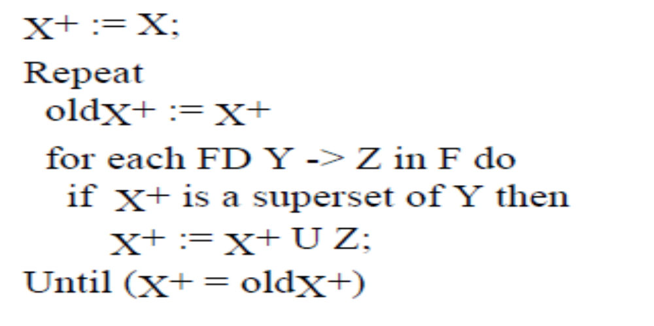
Determining X⁺ under F
Slide 10- <number>

Slide 32
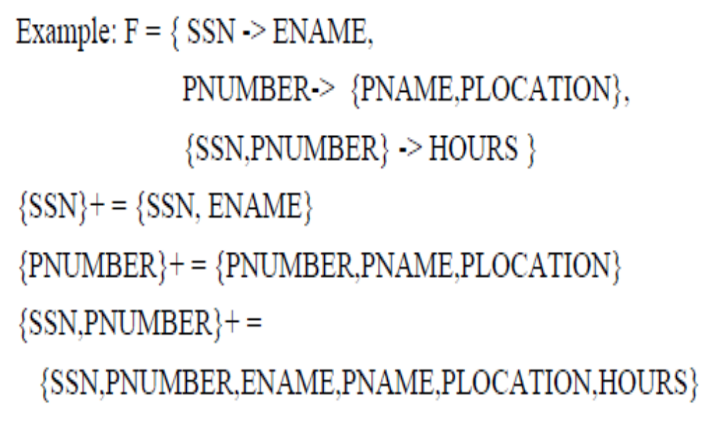
Determining X⁺ under F
Slide 10- <number>

Slide 33
2.3 Equivalence of Sets of FDs
Two sets of FDs F and G are equivalent if:
  Every FD in F can be inferred from G, and
  Every FD in G can be inferred from F
  Hence, F and G are equivalent if F⁺ =G⁺
Definition (Covers):
  F covers G if every FD in G can be inferred from F
    (i.e., if G⁺ subset-of F⁺)
F and G are equivalent if F covers G and G covers F
Slide 10- <number>

Slide 34
2.4 Minimal Sets of FDs
A set of FDs is minimal if it satisfies the following conditions:
  Every dependency in F has a single attribute for its RHS.
  We cannot remove any dependency from F and have a set of dependencies that is equivalent to F.
  We cannot replace any dependency X -> A in F with a dependency Y -> A, where Y proper-subset-of X ( Y subset-of X) and still have a set of dependencies that is equivalent to F.
Slide 10- <number>

Slide 35
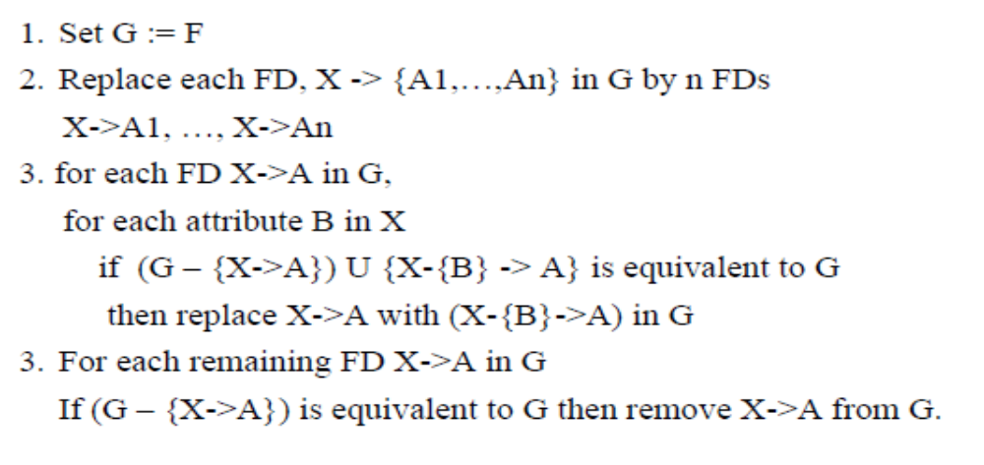
Finding a minimum cover F for a set of functional dependencies E
Slide 10- <number>

Slide 36
3 Normal Forms Based on Primary Keys
3.1 Normalization of Relations
3.2 Practical Use of Normal Forms
3.3 Definitions of Keys and Attributes Participating in Keys
3.4 First Normal Form
3.5 Second Normal Form
3.6 Third Normal Form
Slide 10- <number>

Slide 37
3.1 Normalization of Relations (1)
Normalization:
  The process of decomposing unsatisfactory "bad" relations by breaking up their attributes into smaller relations
  Proposed by ’Codd’
Normal form:
  Condition using keys and FDs of a relation to certify whether a relation schema is in a particular normal form
  The normal form of a relation refers to the highest normal form condition that it meets, and hence indicate the degree to which it has been normalized
Slide 10- <number>

Slide 38
3.1 Normalization of Relations (2)
Normalization, a process of analyzing the given schemas based on their FDs and primary keys to achieve the desirable properties of:
  Minimizing redundancy
  Minimizing insertion, deletion and updation anomalies
Unsatisfactory relation schemas that do not meet certain condition i.e., normal form tests- are decomposed into smaller relation schemas that meet the tests and hence posses the desirable properties.
Slide 10- <number>

Slide 39
Normalization of Relations (3)
2NF, 3NF, BCNF
  based on keys and FDs of a relation schema
4NF
  based on keys, multi-valued dependencies : MVDs; 5NF based on keys, join dependencies : JD
Additional properties may be needed to ensure a good relational design (lossless join, dependency preservation
Slide 10- <number>

Slide 40
3.2 Practical Use of Normal Forms
Normalization is carried out in practice so that the resulting designs are of high quality and meet the desirable properties
The practical utility of these normal forms becomes questionable when the constraints on which they are based are hard to understand or to detect
The database designers need not normalize to the highest possible normal form
  (usually up to 3NF, BCNF or 4NF)
Denormalization:
  The process of storing the join of higher normal form relations as a base relation—which is in a lower normal form
Slide 10- <number>

Slide 41
3.3 Definitions of Keys and Attributes Participating in Keys (1)
A superkey of a relation schema R = {A1, A2, ...., An} is a set of attributes S subset-of R with the property that no two tuples t1 and t2 in any legal relation state r of R will have t1[S] = t2[S]
A key K is a superkey with the additional property that removal of any attribute from K will cause K not to be a superkey any more.
Slide 10- <number>

Slide 42
Definitions of Keys and Attributes Participating in Keys (2)
If a relation schema has more than one key, each is called a candidate key.
  One of the candidate keys is arbitrarily designated to be the primary key, and the others are called secondary keys.
A Prime attribute must be a member of some candidate key
A Nonprime attribute is not a prime attribute—that is, it is not a member of any candidate key.
Slide 10- <number>

Slide 43
3.2 First Normal Form
It states that domain of an attribute must include only atomic (simple, indivisible values) and the value of any attribute in a tuple must be a single value from the domain of that attribute.
Disallows
  composite attributes
  multivalued attributes
  nested relations; attributes whose values for an individual tuple are non-atomic
Considered to be part of the definition of relation
Slide 10- <number>

Slide 44

Normalization into 1NF
Slide 10- <number>

Slide 45
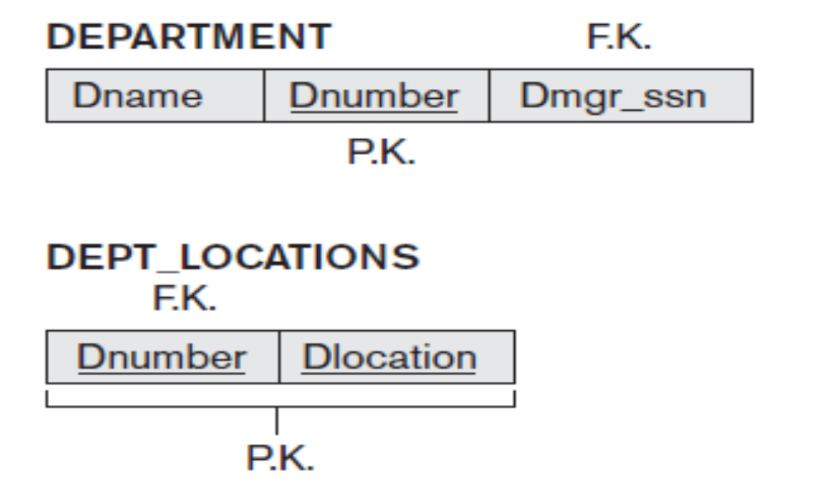
Normalization into 1NF
Slide 10- <number>

Slide 46
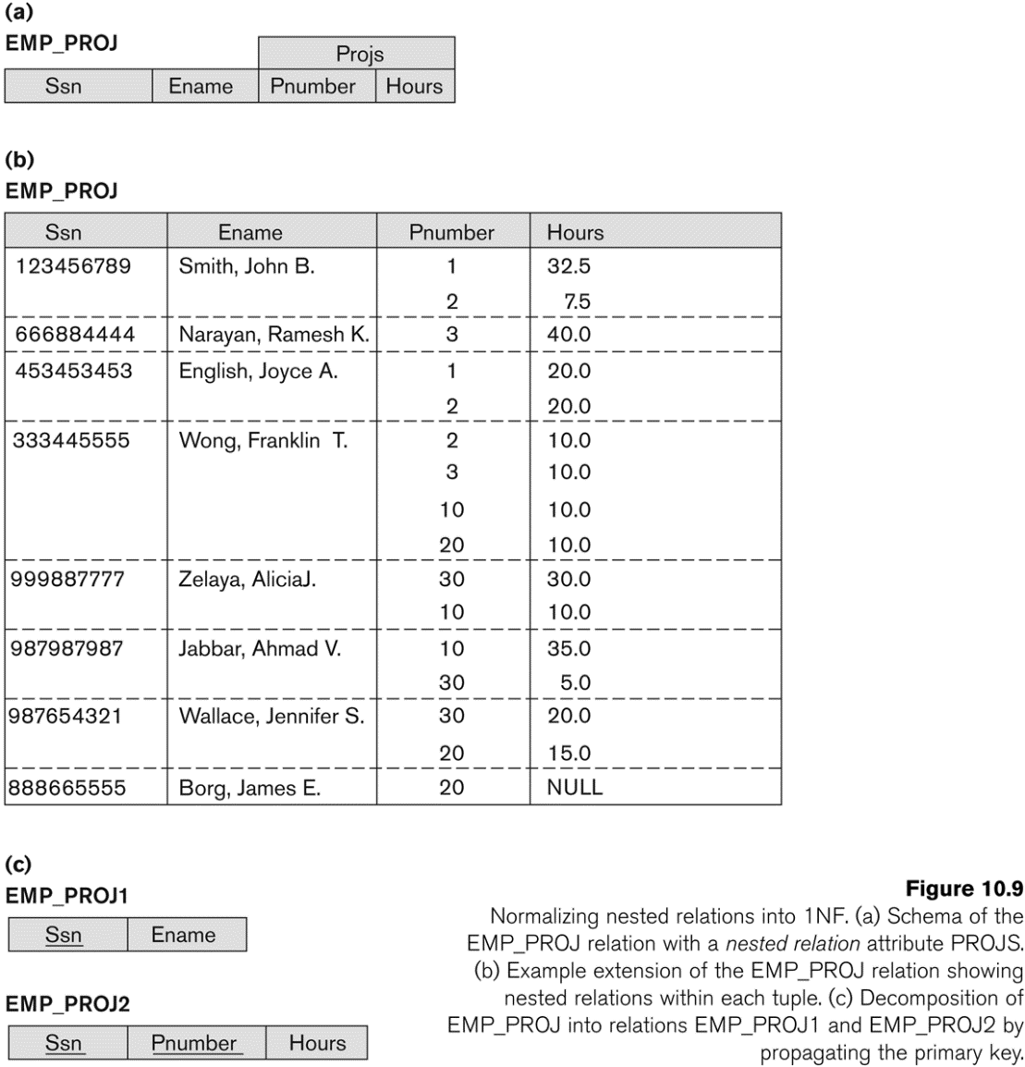
Normalization: nested relations into 1NF
Ssn: primary key
Pnumber: partial key
Slide 10- <number>

Slide 47
3.3 Second Normal Form (1)
Uses the concepts of FDs, primary key
Definitions
  Prime attribute: An attribute that is member of the primary key K
  Full functional dependency: a FD X -> Y where removal of any attribute from X means the FD does not hold any more
  Partial functional dependency
Examples:
  {SSN, PNUMBER} -> HOURS is a full FD since neither SSN -> HOURS nor PNUMBER -> HOURS hold
  {SSN, PNUMBER} -> ENAME is not a full FD (it is called a partial dependency ) since SSN -> ENAME also holds
Slide 10- <number>

Slide 48
Second Normal Form (2)
A relation schema R is in second normal form (2NF) if every non-prime attribute A in R is fully functionally dependent on the primary key
2NF involves testing for FDs whos LHS attributes are part of primary key
If the primary key contains single attribute , the test need not be applied at all
R can be decomposed into 2NF relations via the process of 2NF normalization
Slide 10- <number>

Slide 49
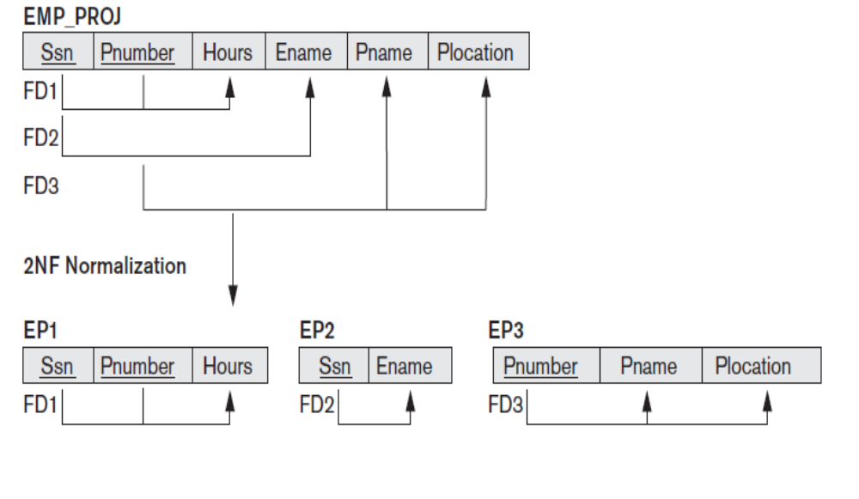
Normalizing into 2NF
Slide 10- <number>

Slide 50
3.4 Third Normal Form (1)
Definition:
  Transitive functional dependency X -> Y in a relation schema R, if there is a set of attributes Z that is neither a candidate key nor a subset of any key of R, and both X -> Z and Z -> Y holds.
Examples:
  SSN -> DMGRSSN is a transitive FD
    Since SSN -> DNUMBER and DNUMBER -> DMGRSSN hold
  SSN -> ENAME is non-transitive
    Since there is no set of attributes X where SSN -> X and X -> ENAME
Slide 10- <number>

Slide 51
Third Normal Form (2)
A relation schema R is in third normal form (3NF) if it is in 2NF and no non-prime attribute A in R is transitively dependent on the primary key
R can be decomposed into 3NF relations via the process of 3NF normalization
Slide 10- <number>

Slide 52
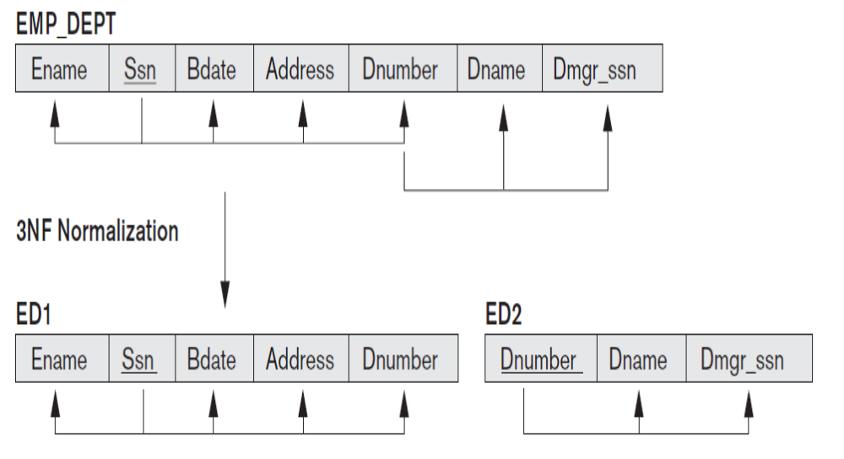
Third Normal Form (3)
Slide 10- <number>

Slide 53
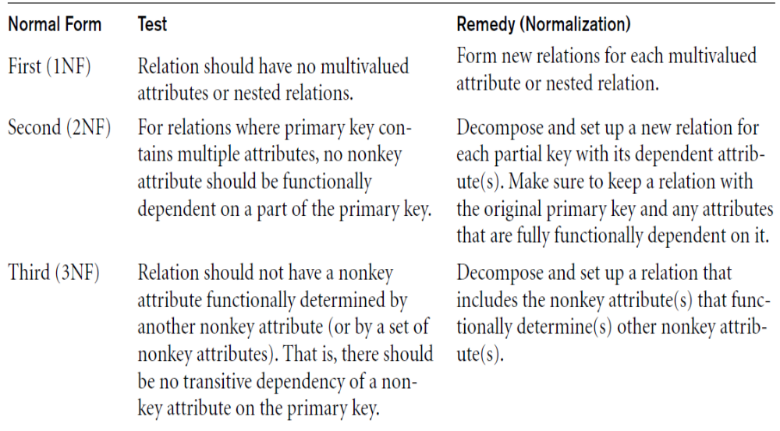
Summary of Normal Forms based on Primary Keys
Slide 10- <number>

Slide 54
4 General Normal Form Definitions (For Multiple Keys) (1)
The above definitions consider the primary key only
The following more general definitions take into account relations with multiple candidate keys
This does not affect the definition of 1NF since it is independent of keys and functional dependencies
Slide 10- <number>

Slide 55
General Normal Form Definitions (2)
A relation schema R is in second normal form (2NF) if every non-prime attribute A in R is fully functionally dependent on any key of R
Example:
  Consider the relation schema LOTS shown in Figure, which describes parcels of lands for sale in various countries of a state
  Candidate keys: {Property_id#}, {County_name, Lot#} i.e., lot numbers are unique only within each county, but Property_id numbers are unique across counties for the entire state
Slide 10- <number>

Slide 56
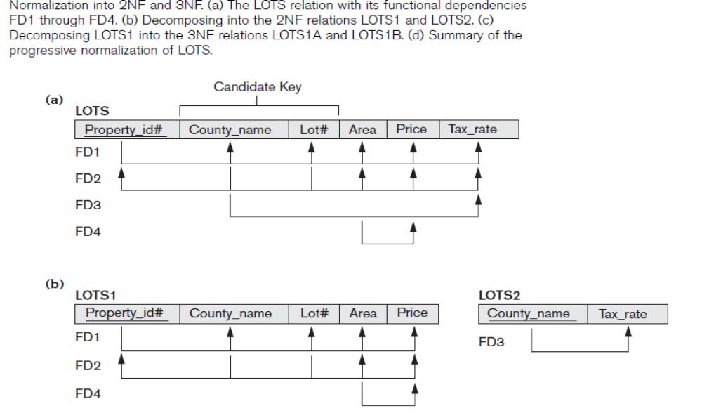
Normalization into 2NF

Slide 57
General Normal Form Definitions (3)
Definition:
  Superkey of relation schema R - a set of attributes S of R that contains a key of R
  A relation schema R is in third normal form (3NF) if whenever a FD X -> A holds in R, then either:
    (a) X is a superkey of R, or
    (b) A is a prime attribute of R
  NOTE: Boyce-Codd normal form disallows condition (b) above
Slide 10- <number>

Slide 58
General Normal Form Definitions (4)
A relation schema R violates the general definition of 3NF if a functional dependency X → A holds in R that does not meet either condition; meaning that it violates both conditions (a) and (b) of 3NF. This can occur due to two types of problematic functional dependencies:
  A nonprime attribute determines another nonprime attribute. Here we typically have a transitive dependency that violates 3NF.
  A proper subset of a key of R functionally determines a nonprime attribute. Here we have a partial dependency that violates 3NF (and also 2NF).
Slide 10- <number>

Slide 59
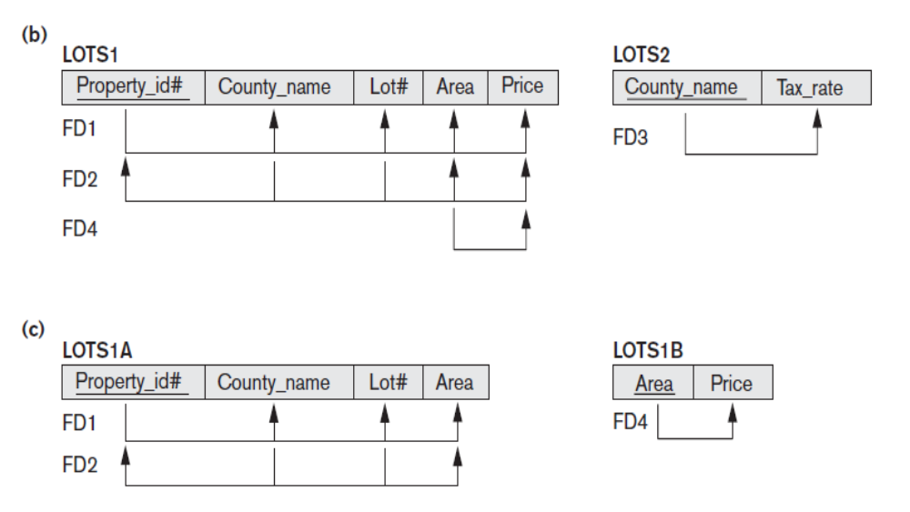
Normalization into 3NF

Slide 60
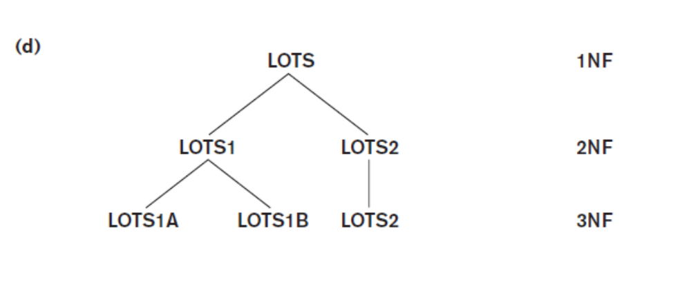
Normalization into 2NF and 3NF
Slide 10- <number>

Slide 61
5 BCNF (Boyce-Codd Normal Form)
A relation schema R is in Boyce-Codd Normal Form (BCNF) if whenever an FD X -> A holds in R, then X is a superkey of R
Each normal form is strictly stronger than the previous one
  Every 2NF relation is in 1NF
  Every 3NF relation is in 2NF
  Every BCNF relation is in 3NF
There exist relations that are in 3NF but not in BCNF
The goal is to have each relation in BCNF (or 3NF)
The decomposition in BCNF may result in loss of dependency preservation
Slide 10- <number>

Slide 62
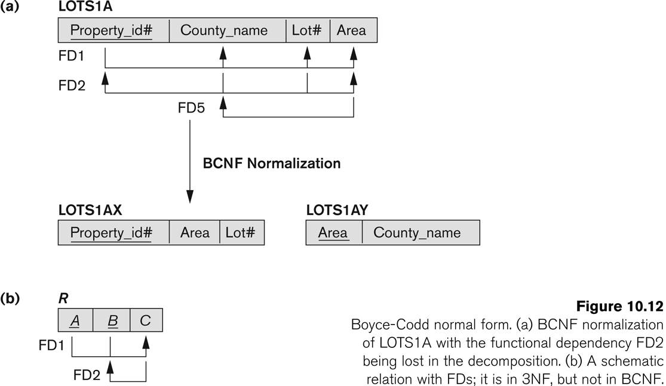
Boyce-Codd normal form
Slide 10- <number>

Slide 63
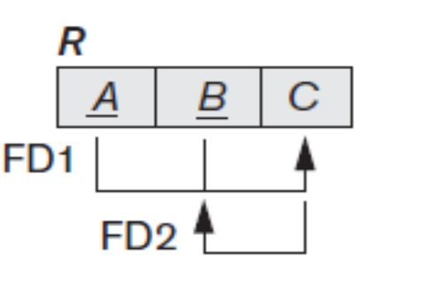

A relation TEACH that is in 3NF but not in BCNF
FD1: {Student, Course} -> Instructor
FD2: Instructor -> Course
Slide 10- <number>

Slide 64
Achieving the BCNF by Decomposition (1)
Two FDs exist in the relation TEACH:
  FD1: { student, course} -> instructor
  FD2: instructor -> course
{student, course} is a candidate key for this relation and that the dependencies shown follow the pattern in Figure 10.12 (b).
  So this relation is in 3NF but not in BCNF
A relation NOT in BCNF should be decomposed so as to meet this property, while possibly forgoing the preservation of all functional dependencies in the decomposed relations.
Slide 10- <number>

Slide 65
Achieving the BCNF by Decomposition (2)
Three possible decompositions for relation TEACH
  {student, instructor} and {student, course}
  {course, instructor } and {course, student}
  {instructor, course } and {instructor, student}
All three decompositions will lose FD1.
  We have to settle for sacrificing the functional dependency preservation. But we cannot sacrifice the non-additivity property after decomposition.
Out of the above three, only the 3rd decomposition will not generate spurious tuples after join.(and hence has the non-additivity property).
A test to determine whether a binary decomposition (decomposition into two relations) is non-additive (lossless) is discussed in section 11.1.4 under Property LJ1. Verify that the third decomposition above meets the property.
Slide 10- <number>

